Slide 1
Assessment Discussion
Student Achievement Committee Meeting
January 9, 2014

Slide 2
Case21 Benchmark Assessments
2nd full year of implementing quarterly benchmarks
Grades 2-8
Language Arts
Mathematics
Science (Grades 5&8)
Given three times year each year
High School
English II, CC Math I, Biology
Given twice in a semester block course

Slide 3
Case21 Benchmark Assessments
Questions are tightly aligned to Common Core State Standards & North Carolina Essential Standards
Assessments are aligned to WCPSS pacing guides
Format & question stems mirror state tests (EOG/EOC)
Assessments are 30-70 items in length depending on content and timing within the course

Slide 4
Case21 Benchmark Assessments
Reporting
Schools receive results in report format within 48 hours
Class, school, and district level data
Projected achievement levels
Projected scale scores
Webb’s Depth of Knowledge data
Data specific to individual standards assessed

Slide 5
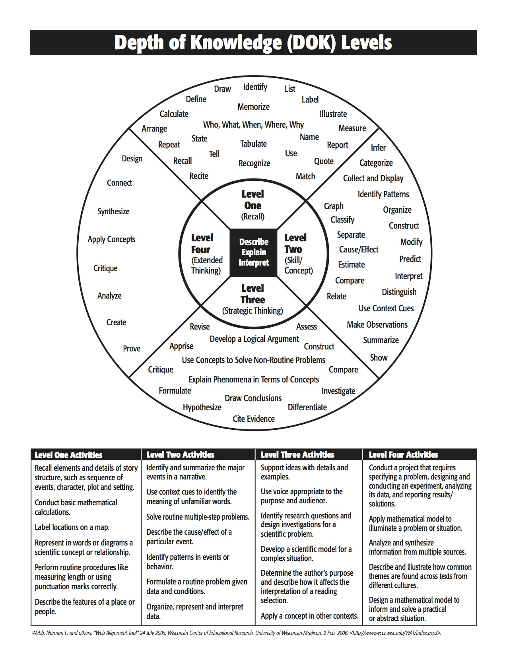

Slide 6
Core Literacy: Assessing Reading Multiple Measures
Core Assessment/Basic Reading Inventory is a diagnostic tool which assesses the student’s transfer/application skills
Provides specific information on specific concepts
Phonics
Syllable type
Vocabulary
High Frequency Words
Listening Comprehension
Guides the development of student’s IEP goals
Given three times per year (beginning, middle, end)

Slide 7
iReady Diagnostic Assessment
Online adaptive K-12 Math Diagnostic
Assesses down to the Common Core Sub-Skill Level
Developmental exam that guides the identification of student’s IEP goals
Guides the implementation of specially designed instruction/intensive instructional strategies
Provides teachers on-line lesson plans based on the diagnostic needs of students
Given three times per year (beginning, middle, end)

Slide 8
Path Driver
Online assessment tool for administering universal screeners in reading and math in grades 6-8
Currently at 21 middle schools with remaining middle schools to be added next year
Reading and math screeners can be administered in 20-25 minutes combined and are administered three times per year
Provides:
Consistency of data and language about learning across middle schools
Automated scoring of assessments
An independent data point to assess effectiveness of core instruction and intervention efforts
An additional data point used in conjunction with other data points to inform scheduling, enrollment in intervention programs, etc.

Slide 9
Began in WCPSS in fall of 2009 with 3 schools
Barwell, Brentwood, Creech, and Wilburn
Added 12 schools in winter of 2009-2010
Brentwood, Forestville, Fuquay Varina, Green, Hodge, Lockhart, Northwoods, RiverBend, Timber Drive, Wakelon, Washington, Vandora Springs
Rolled out in all schools in fall of 2013 as part of the Excellent Public Schools Act
Notes:
mCLASS Reading 3D has been in Wake County since the fall of 2009 when three of our schools were identified by DPI to participate in a pilot. Twelve additional schools joined the pilot during the winter of 2009-2010. In the fall of 2013, it was rolled out in all of our schools as part of the Excellent Public Schools Act. DPI funded the initiative in grades K-3 and Wake County made the decision to purchase the universal screening portion, DIBELS Next, for grades 4-5 to insure consistent data across the system. This replaced AIMSweb that had previously been used.

Slide 10
mCLASS®:Reading 3D™ System
Notes:
The mCLASS® solution consists of two components: the mobile device (our iPad) and Web reports.
The system streamlines assessment processes by
Tracking time
Performing fluency calculations
Applying scoring rules
Individual assessments run smoothly as everything needed to assess the student is found within the device and the supporting materials
The system provides data immediately.
View results directly following completion of a measure.
See a snapshot of student progress.
Use information to affect instruction the same day.
Tap, record, and sync student responses to a secure Web-based server for instant analysis.

Slide 11
mCLASS
Reading 3D
DIBELS Next
DORF
Daze
Early Literacy Diagnostic
(ELD)
Text Reading & Comprehension
(TRC)
NWF
PSF
FSF
Word Recognition
(WR)
Notes:
So, what is mCLASS Reading 3D? There are two components to the assessment – DIBELS Next and Early Literacy Diagnostic probes. The DIBELS Next probes are the universal screening measures that we will now be using and you will notice the similarities with AIMSweb. The two components of the Early Literacy Diagnostic are the TRC – Text Reading and Comprehension (what you knew as running records and retelling) and Word Recognition.
There is also an alignment to the ELA Common Core State Standards.

Slide 12
Basic Early Literacy Skills
Phonemic Awareness
Phonics
Accurate and Fluent Reading of Connected Text
Reading Comprehension
Vocabulary and Language Skills
Notes:
mCLASS assesses the basic early literacy skills of Phonemic Awareness, Phonics, Accurate and Fluent Reading of Connected Text, Reading Comprehension, and Vocabulary and Language Skills through brief, one minute probes using DIBELS Next and reading of connected text through the Text Reading Comprehension also known as running records. These measures provide teachers with information to plan instruction as well as measuring the student’s growth on their reading path.

Slide 13
Benchmark Goals
Status | Odds of Achieving Subsequent Benchmark Goals | Next Steps
At or Above Benchmark | 80% - 90% | Student is likely to make adequate progress with effective core instruction.
Below Benchmark | 40% - 60% | Student is likely to need strategic support to make adequate progress.
Well Below Benchmark | 10% – 20% | Student is likely to need intensive support to make adequate progress.
Notes:
The color-coded Benchmark goals represent odds and likelihood.
If a student achieves a Benchmark goal, the odds are in favor of that student achieving later reading outcomes.
A Benchmark goal is:
An empirically derived, criterion-referenced target score
The lowest level of performance on a measure that predicts reaching the next goal
Comprised of three parts: a Basic Early Literacy Skill, a level of performance, and a point in time
Based on longitudinal research examining how a score on a measure at a point in time predicts later reading outcomes
Use Benchmark goals:
To predict which students are likely to need more support.
To establish meaningful targets for intervention and instruction that will change the future for students.
As a framework for evaluating systems goals and outcomes as well as individual goals and outcomes.

Slide 14
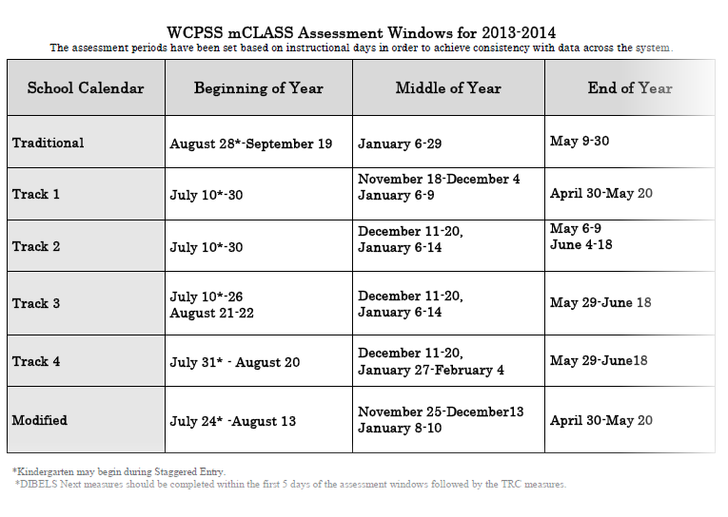
Notes:
mCLASS assessments are administered three times per year. The assessment calendar is designed so that all students, regardless of calendar, are assessed after approximately the same number of days of instruction. This allows us to have consistent data across the district to guide decision-making (staff development, resources, etc.).
Schools typically use both a team and teacher approach to assessment. School teams may assist the teacher in administering the DIBELS Next measures and then offer support as the K- 3 classroom teacher administers the TRC (Text Reading Comprehension). All of the assessments are completed individually with the exception of the DAZE which is administered whole group in grades 3 – 5.

Slide 15
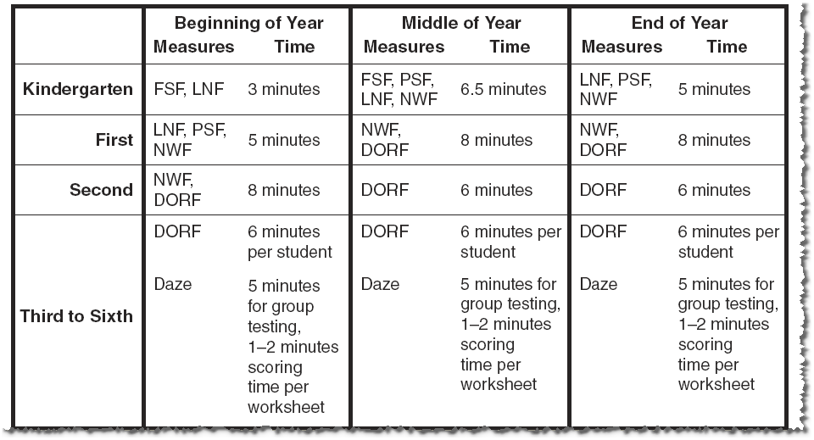
Administration Time
Notes:
Here you can see how long it takes to administer DIBELS measures to each student. This will help you plan as you are incorporating these into your instructional day. As you can see 1st grade MOY through 2nd grade EOY assessments are likely going to take the most administration time.

Slide 16
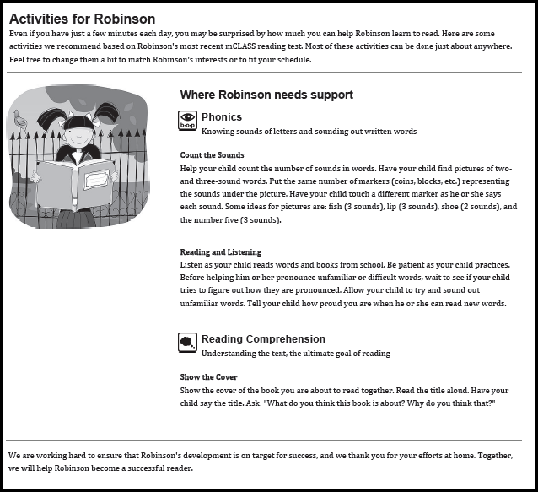
Home Connect Letters
Notes:
Using the Now What? Tools, teachers can generate Home Connect Letters for each student after the benchmarking period. These letters provide parents with information about their student’s progress as well as some recommendations for things they can do to work with their child at home. The letters are available in both English and Spanish. Steve Moore at Fuquay shared that his teachers use this in parent conferences to help parents see their student’s strengths and needs.

Slide 17
Small Group Advisor
Notes:
Another component of the Now What tools is the Small Group Advisor. This tool will group students based on their performance on one of the probes. This information can help teachers and Tier II interventionists identify small strategy groups that they can support.

Slide 18
Item-Level Advisor
Notes:
The final tool in the Now What? Suite is the Item-Level Advisor. This tool analyzes an individual student’s probe and identifies observations about the students errors, if possible. If it makes observations, it will provide some suggested activities. The activities are hotlinks that the teacher can access all of the information needed to complete the activity and/or intervention with a student.

Slide 19
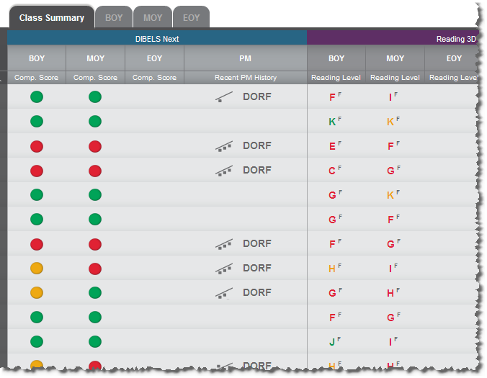
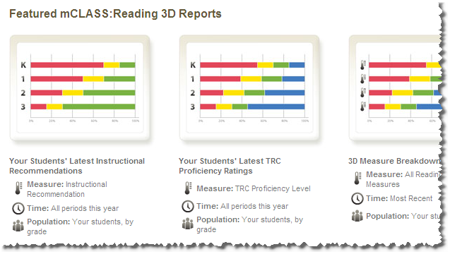
mCLASS Reports
Notes:
mCLASS provides a variety of reports that can be used to make instructional decisions, monitor student progress and growth, and compare classrooms and subgroups to others in Wake County.

Slide 20
DIBELS Next
Letter Naming Fluency
First Sound Fluency
Phoneme Segmentation Fluency
Nonsense Word Fluency
Oral Reading Fluency
Text Reading Comprehension
Running record
Oral and Written Retell
Literary and informational selections
Comprehension questions
Vocabulary in context questions

